Slide 1
July13-24

Slide 2
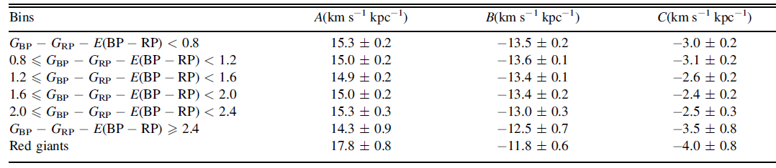
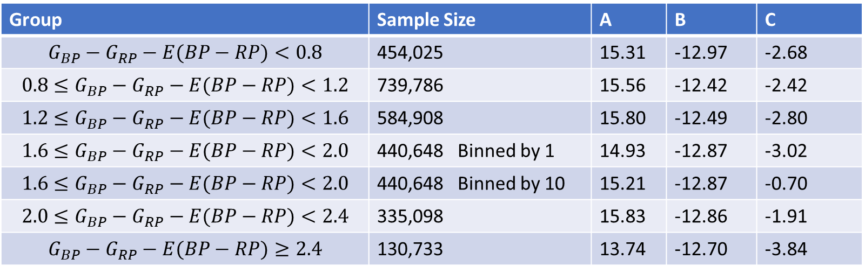

$$μ_{l}$$
Group | Sample Size | A | B | C
$$G_{BP}−G_{RP}−E(BP−RP)<0.8$$ | 454,025 | 15.31 | -12.97 | -2.68
$$0.8≤G_{BP}−G_{RP}−E(BP−RP)<1.2$$ | 739,786 | 15.56 | -12.42 | -2.42
$$1.2≤G_{BP}−G_{RP}−E(BP−RP)<1.6$$ | 584,908 | 15.80 | -12.49 | -2.80
$$1.6≤G_{BP}−G_{RP}−E(BP−RP)<2.0$$ | 440,648 Binned by 1 | 14.93 | -12.87 | -3.02
$$1.6≤G_{BP}−G_{RP}−E(BP−RP)<2.0$$ | 440,648 Binned by 10 | 15.21 | -12.87 | -0.70
$$2.0≤G_{BP}−G_{RP}−E(BP−RP)<2.4$$ | 335,098 | 15.83 | -12.86 | -1.91
$$G_{BP}−G_{RP}−E(BP−RP)≥2.4$$ | 130,733 | 13.74 | -12.70 | -3.84

Slide 3
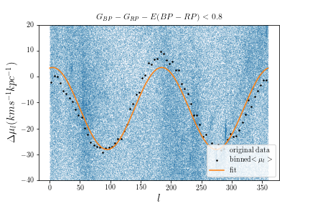
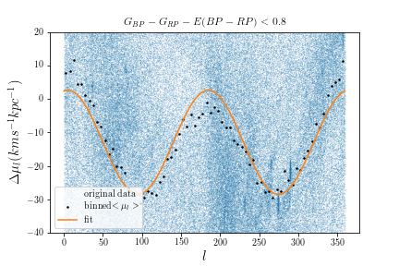
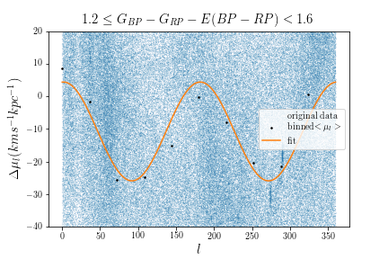
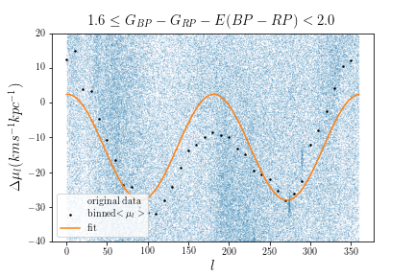
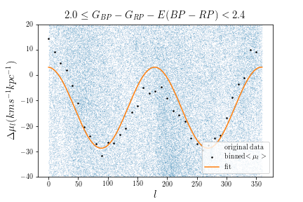
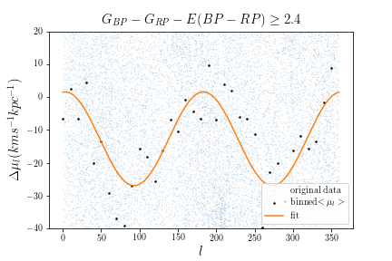
Binned by 10 degree
(Li: 36degree per bin)
(Bovy:360/45 = 8 degree per bin)

Slide 4
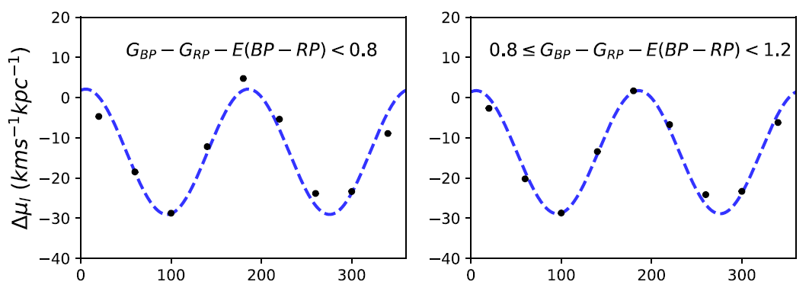
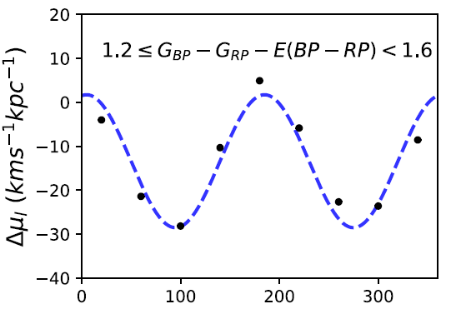
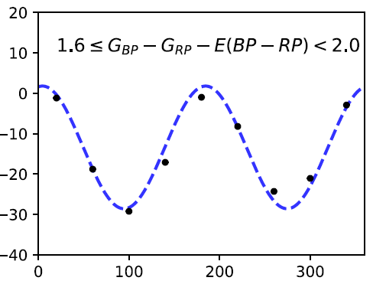
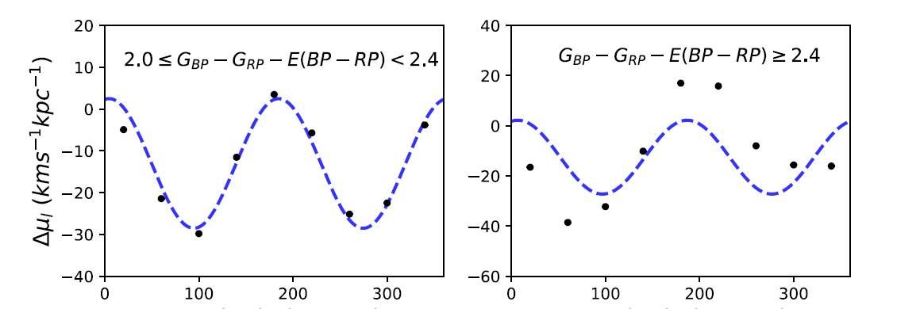
Li,2019

Slide 5
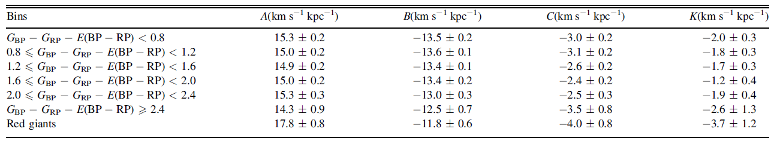

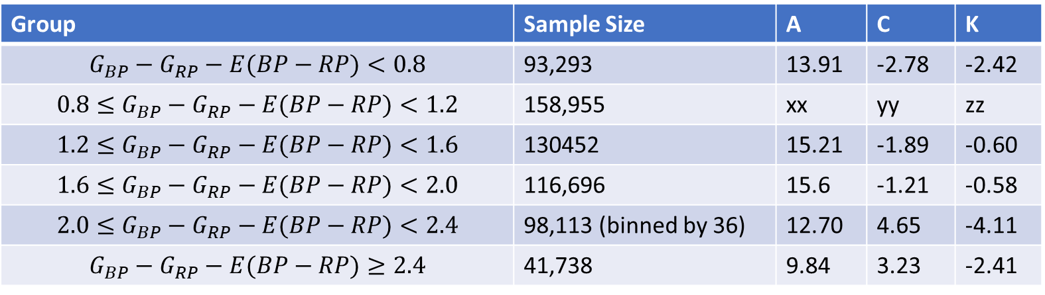
$$μ_{b ,}40<\left|b\right|<50$$
Group | Sample Size | A | C | K
$$G_{BP}−G_{RP}−E(BP−RP)<0.8$$ | 93,293 | 13.91 | -2.78 | -2.42
$$0.8≤G_{BP}−G_{RP}−E(BP−RP)<1.2$$ | 158,955 | xx | yy | zz
$$1.2≤G_{BP}−G_{RP}−E(BP−RP)<1.6$$ | 130452 | 15.21 | -1.89 | -0.60
$$1.6≤G_{BP}−G_{RP}−E(BP−RP)<2.0$$ | 116,696 | 15.6 | -1.21 | -0.58
$$2.0≤G_{BP}−G_{RP}−E(BP−RP)<2.4$$ | 98,113 (binned by 36) | 12.70 | 4.65 | -4.11
$$G_{BP}−G_{RP}−E(BP−RP)≥2.4$$ | 41,738 | 9.84 | 3.23 | -2.41

Slide 6
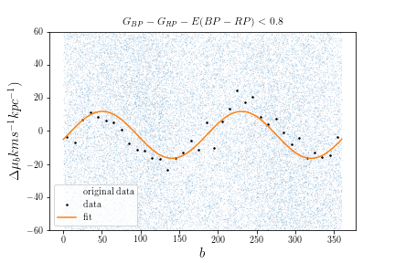
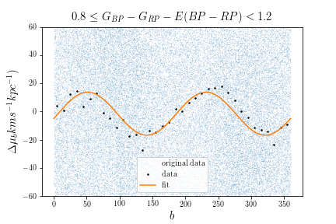
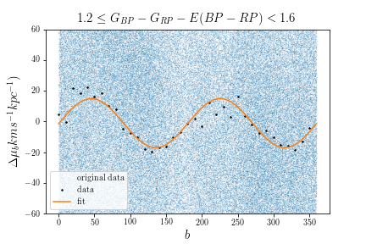
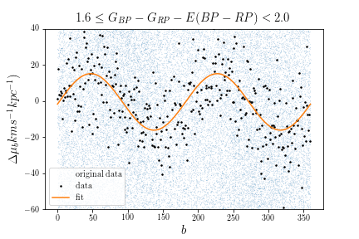
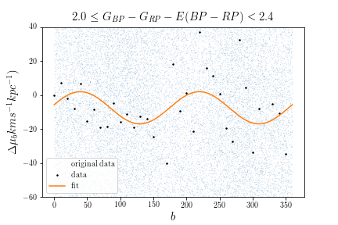
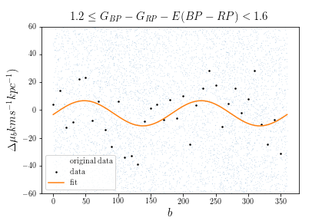
Binned by 10 degree
(Li: 36degree per bin)
(Bovy:360/45 = 8 degree per bin)
$$G_{BP}−G_{RP}−E(BP−RP)≥2.4$$
(Binned by 1 degree)

Slide 7
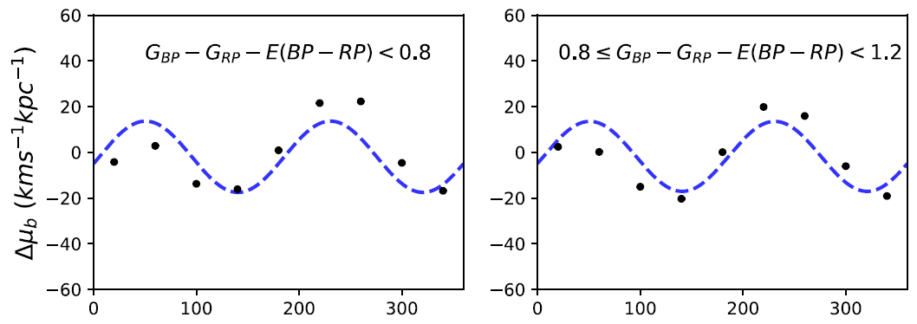
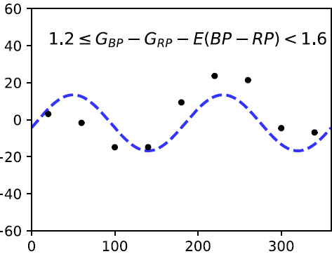
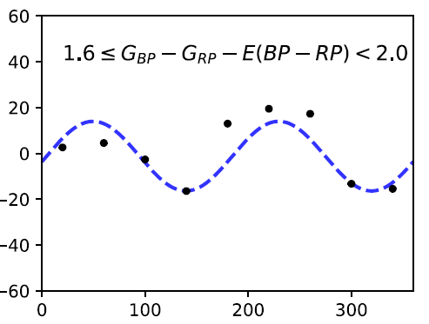
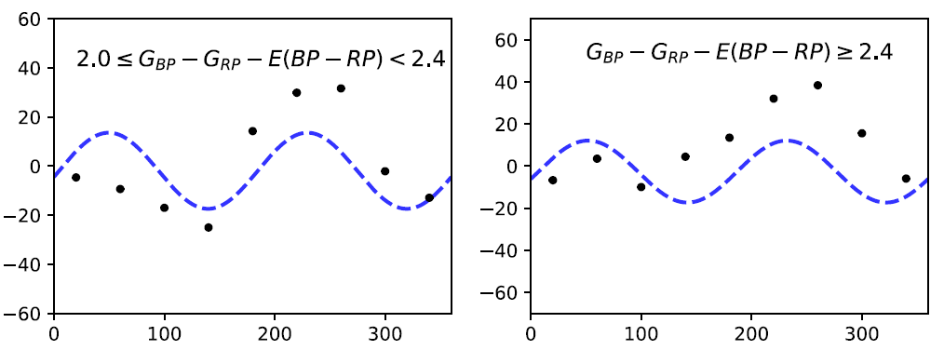
Li,2019

Slide 8
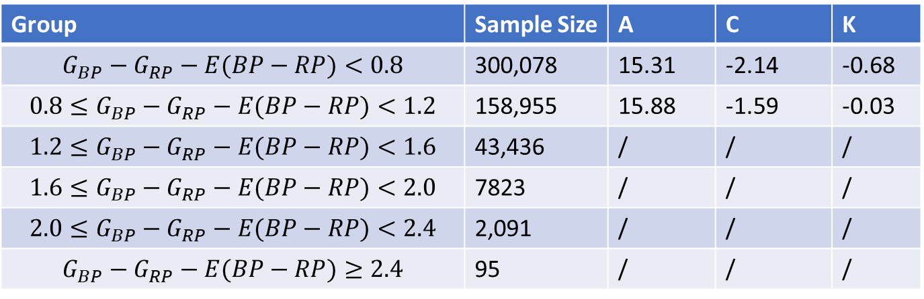

$$v_{los}$$
Group | Sample Size | A | C | K
$$G_{BP}−G_{RP}−E(BP−RP)<0.8$$ | 300,078 | 15.31 | -2.14 | -0.68
$$0.8≤G_{BP}−G_{RP}−E(BP−RP)<1.2$$ | 158,955 | 15.88 | -1.59 | -0.03
$$1.2≤G_{BP}−G_{RP}−E(BP−RP)<1.6$$ | 43,436 | / | / | /
$$1.6≤G_{BP}−G_{RP}−E(BP−RP)<2.0$$ | 7823 | / | / | /
$$2.0≤G_{BP}−G_{RP}−E(BP−RP)<2.4$$ | 2,091 | / | / | /
$$G_{BP}−G_{RP}−E(BP−RP)≥2.4$$ | 95 | / | / | /

Slide 9
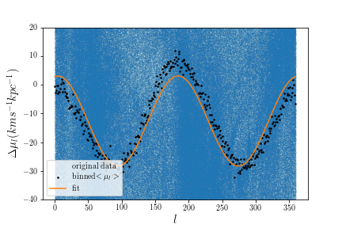
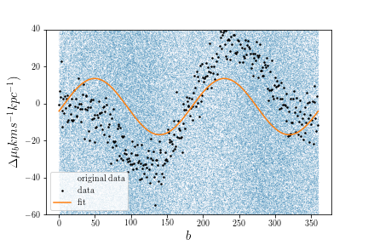


take the average of the results from each color bin, using mean solar velocity
$$μ_{l}$$
A=15.51
B=-12.63
C=-2.35
A=15.0
C=-2.43
D=-1.75
$$μ_{b ,}$$

Slide 10
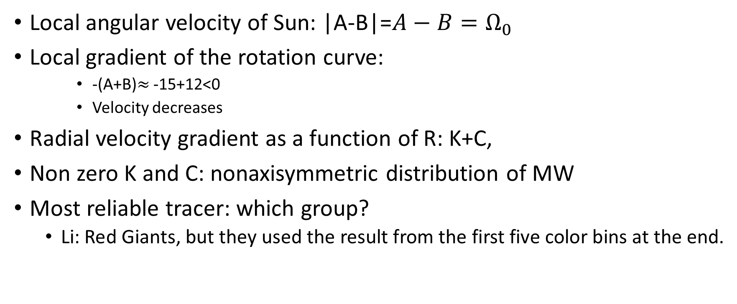
Implications
Local angular velocity of Sun: |A-B|=$A−B=Ω_{0}$
Local gradient of the rotation curve:
-(A+B)$≈$ -15+12<0
Velocity decreases
Radial velocity gradient as a function of R: K+C,
Non zero K and C: nonaxisymmetric distribution of MW
Most reliable tracer: which group?
Li: Red Giants, but they used the result from the first five color bins at the end.

Slide 11
From Oort constant A→ know vc(R) profile
do we already know vc(R) of the MW?
possibility to visualize differential rotation?

Slide 12
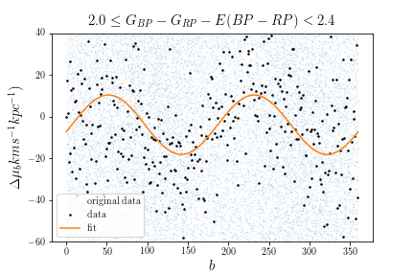
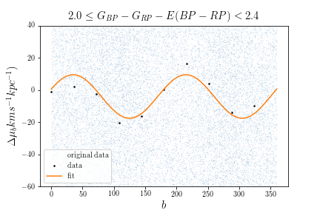
Compare bin size
By 1, by 10, by 36 degree
Binned by 1 degree: too detailed, too scatter
Binned by 36 degree: too coarse

Slide 13
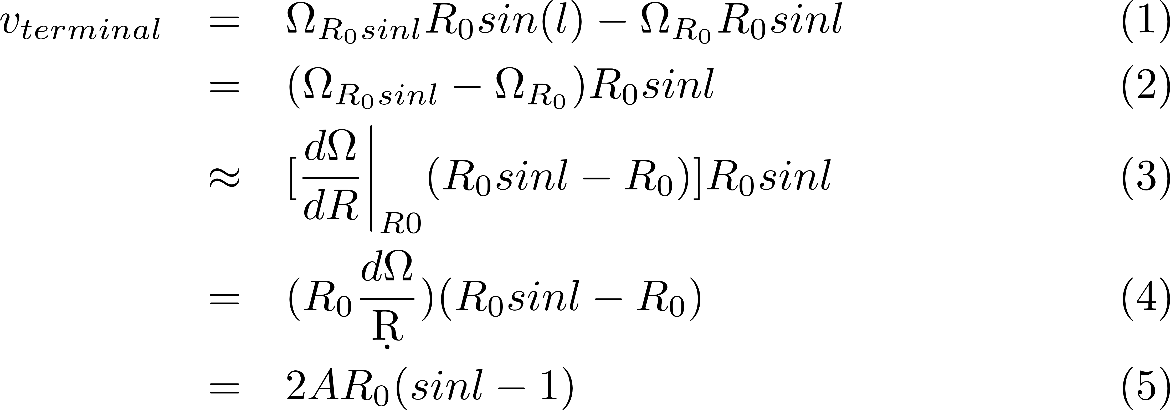
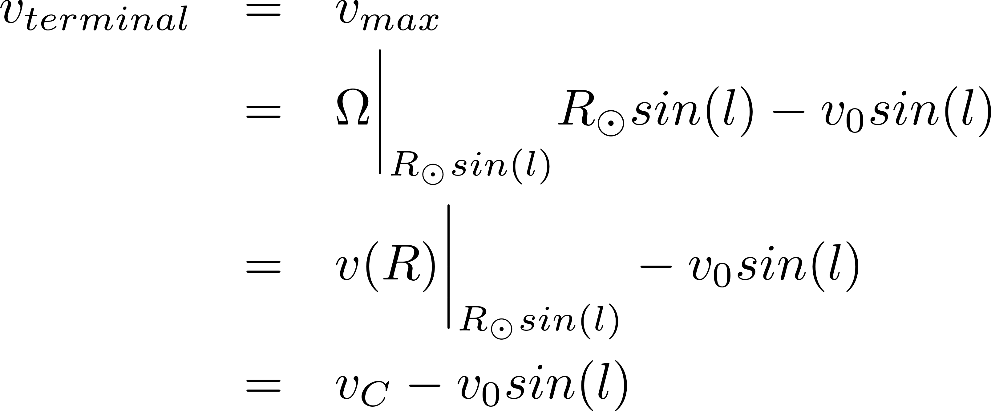
Terminal velocity

Slide 14
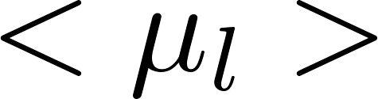
MCMC error propagation
Q: Which way to find the error of y-values ?
To-do: Determine uncertainty from MCMC: standard deviation of the Gaussian distribution for each parameter

Slide 15
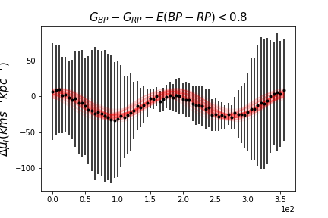
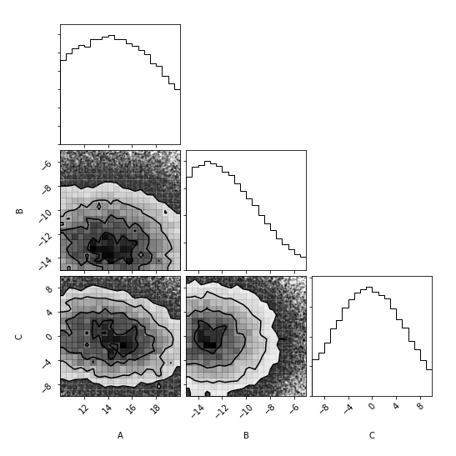
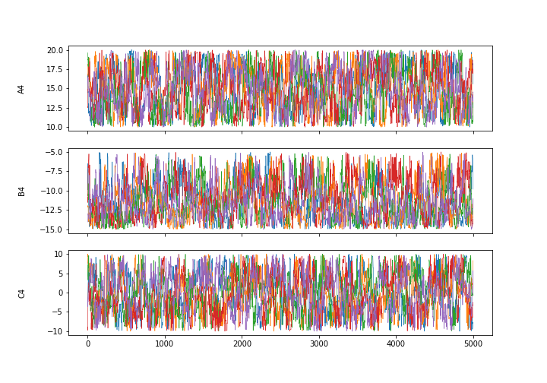
1) For each bin

Slide 16
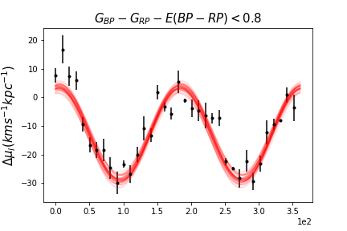
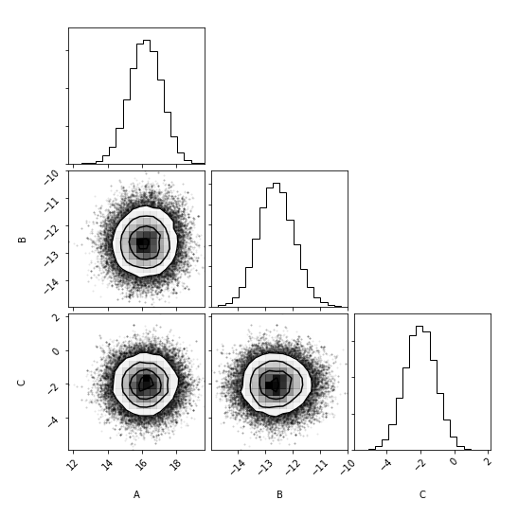
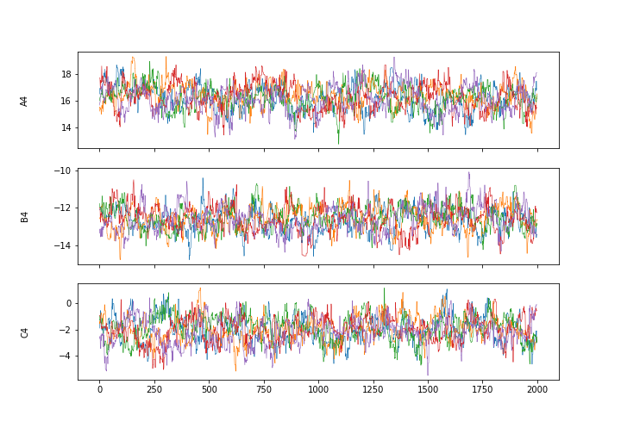
2) For each bin

